Slide 1
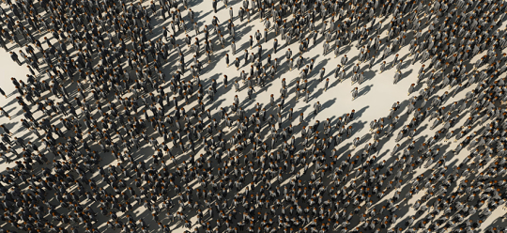
Inequality by Demographic Factors
Findings from Individual-Level Cantonal Tax Data
Rudolf Farys und Oliver Hümbelin

Slide 2
Introduction
Current Development in Europe: Older, more numerous and diverse (Demography report 2010)
This holds for Swizterland too:
In the last 30 year Population grow by 1.8 Mio (Source: STATPOP)
A central part of the growth is due to Migration (average anual net migration since the 1980 is +28’000 Source: PETRA/STATPOP)
Swiss Population is ageing (Share of 65+: 1980: 14%, 2012: 17%, estimated in 2030: 24% Source: ESPOP, STATPOP, SCENARIO)
Cowell (2000): “It is almost essential to attempt to ‘account for’ the level of, or trend in, inequality by components of the population.”
Our central Research Question is: How is economic inequality affected by demographic factors?
Notes:
Bevölkerung nach Alter
http://www.bfs.admin.ch/bfs/portal/de/index/themen/01/02/blank/key/alter/gesamt.html
Migration und Integration
http://www.bfs.admin.ch/bfs/portal/de/index/themen/01/07/blank/data/01.html

Slide 3
Theory
Demographic change and Inequality
Ageing of the population leads to a conflict between generations (Kaufmann 2005), because the financial feasibility of social security is beeing tested.
Change in the «way of living» affects inequality (people marry later, and divorce more often). Daly and Valetta (2006) think that part of the rise in inequality in the US is due to the rise of people living alone (especialy single parents)
Migration leads to more inequality a) because of the rise of unskilled labourforce, which leads to presure on low-wages, b) global economy results in increase of highly qualified, high-earnings «expads».
Two relevant «processes» must be separated
(1) Demographic changes affects overall Distribution
(2) Demographic changes lead to segmentation and therefore affects between group differences (which doesn’t necessarily affect overal distribution).
Notes:
- Weiterer Punkt: Between group differences are particularly interessting for Familienpolitischen Verteilungsfragen. Es Unterschiede zwischen verschiedenen Haushaltsformen> Unterschiede zwischen Haushalten mit und ohne Kinder.

Slide 4
Data
Individual cantonal Tax Data -> SNF-Project (http://inequalities.ch/)
Agegroups and Housholdstructure analysis
Jura 2006 – 2012 totalincome
canton with high share of rural population
>BS 1991 – 2011 stbein
Urban canton
Migration and inequality
Obwalden - 2012, ZH - 2004
Variables
Agegroups
-25, 26-65, >65
>Altersquotient abgebildet
«Houshold»structure
Married withoud/with kids
Single mom/dad
Single man/woman
Taxable income/total income
Notes:
Regionalporträts der Kantone
http://www.bfs.admin.ch/bfs/portal/de/index/regionen/kantone/ju/key.html
http://www.bfs.admin.ch/bfs/portal/de/index/regionen/kantone/bs/key.html
Tax data is administrative data, which means it’s a processgenerated, non-reactive datasource (Diekman 2009:653)
Nice, because data coverage is good (no sample bias)
Bad, because data doesn’t necessairly fit the ideas of reaserach purpose. Tax Units are necessairly housholds > in generall we overestimate people living «alone»

Slide 5
Method
«Statistical case study»
Migration and inequality
> Obwalden - 2012, ZH - 2004
Definition of Zugewanderte

Slide 6
Method
Decomposing within and between group inequality
Theil-Index, a inequality measure developed from information theory, is additively decomposable (gini is not). Theil can be expressed as the between-group inequality plus the weighted sum of the inequality within each group
Formula:
By decomposing the Theil-Index we partitioned the total income inequality into between-group inequality (between age groups and household types) and within-group inequality. Hence we see, how the differences between and within each group contribute to overall inequality
Notes:
Remarks - you get between group inequality by assigning the group mean to every group member and the calculate the inequaltiy meassure
- The within group inequality indices are weighted with the adjusted group proportion > with large groups the weights seem to sum to 1. Adjustment is important for small sample size

Slide 7
Method
Plan of Analysis – so far…
Steps of analysis I
(1) Mean income and proportion of social structure variables t1&t2
See structural change and between group inequality
(2) Change of inequality looking at a) p10/p50 b) p90/p50 c) Gini d) Theil
See change of overall inequality
Steps of analysis II
(3) Contribution of Between-Group Components to Income Inequality
How do group mean differences contribute to total inequality?
(4) Decomposing Trends of Income Inequality
Counterfactual Decomposition of unobserved and observed sorting mechanisms while holding other variables constant > Quantile Regression model & Machado and Mata (2005) approach

Slide 8
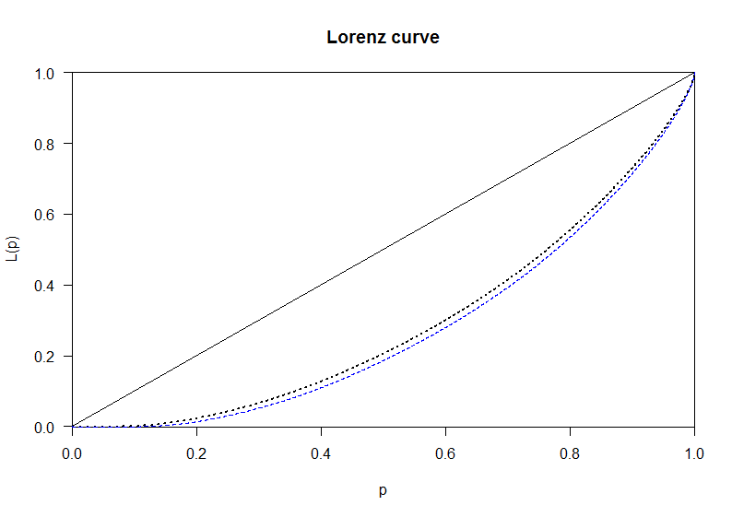
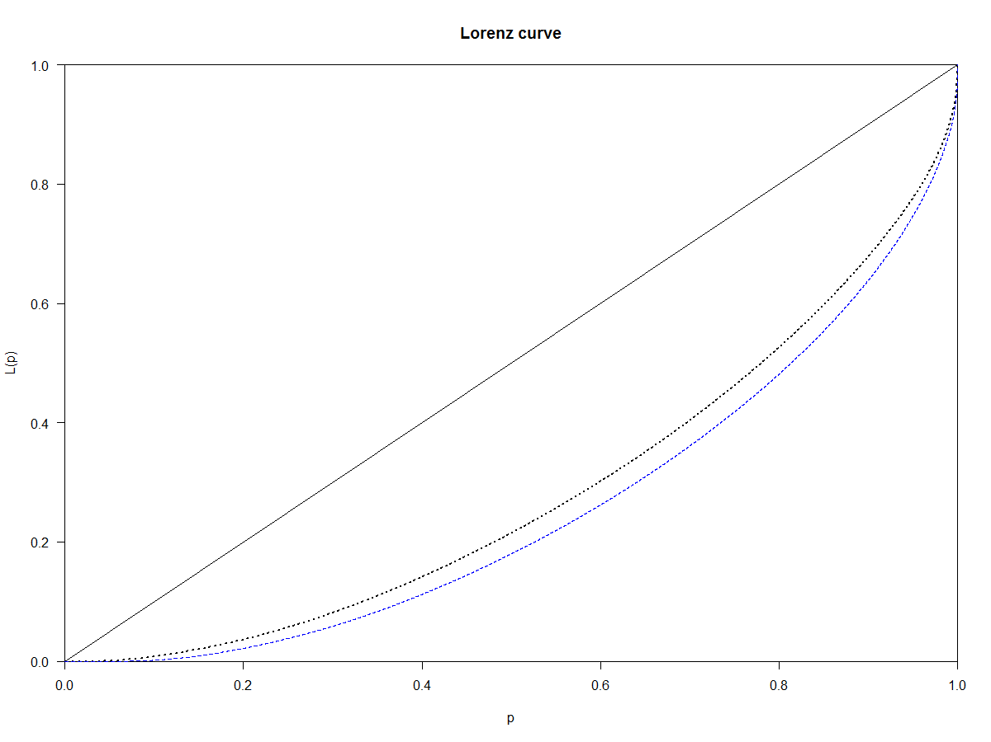
HH / Age results so far…
Overall Inequality over time
BS – 1991 - 2011
Jura – 2006 - 2012
Notes:
Muss man sich noch überlegen, wie das genau dargestellt werden soll

Slide 9
HH / Age results so far…
Decomposing inequality by agegroups
BS
Between group differences contribute little to overall inequality
Weitere zentrale Ergebnisse
Jura
Between group differences contribute a lot to overall inequality
Weitere zentrale Ergebnisse
Notes:
Muss man sich noch überlegen, wie das genau dargestellt werden soll

Slide 10
HH / Age results so far…
Decomposing inequality by household typ
BS
Between group differences contribute little to overall inequality
Weitere zentrale Ergebnisse
Jura
Between group differences contribute a lot to overall inequality
Weitere zentrale Ergebnisse
Notes:
Muss man sich noch überlegen, wie das genau dargestellt werden solll

Slide 11
HH / Age results so far…
In depth distributional analysis of between group differences
BS
Jura
Notes:
Muss man sich noch überlegen, wie das genau dargestellt werden solll

Slide 12
Conclusion und outlook
Notes:
Muss man sich noch überlegen, wie das genau dargestellt werden solll

